Slide 1

Product Development Plan
Team 1: Rachana, Shruti, Mihir, William, Patrick

Slide 2
Table of contents
01
02
03
04
Aggregate Planning
Sales and Operations Planning
Material Requirement Planning
Enterprise Resource Planning

Slide 3

01
Aggregate Planning
Slide by Mihir

Slide 4
Aggregate Planning
Demand Forecast
Inventory Management
Production Capacity
1000 units of water management systems anticipated.
400 units per month. 20 full time employees. Equipment is sufficient to meet production capacity.
200 units of inventory.
Production Planning
Financial Planning
Q1: January to March | 250
Q2: April to June | 246
Q3: July to September | 262
Q4: October to December | 242
Total Cost per Unit | $158.62
Selling Price (Cost Plus Pricing Model) | $174.48
Net Sales | $174,480.00
Net Income | -$492,290.93
Slide by Mihir

Slide 5
Aggregate Planning
Risk Management
Risks
Supply chain disruptions
Regulatory changes
Contingency Plans
Alternative suppliers
Performance Measurement and Monitoring
Key Performance Indicators
Production Efficiency: 90%
Customer Satisfaction: 95%
Slide by Mihir

Slide 6

02
Sales and Operations Planning
Slide by Shruti

Slide 7
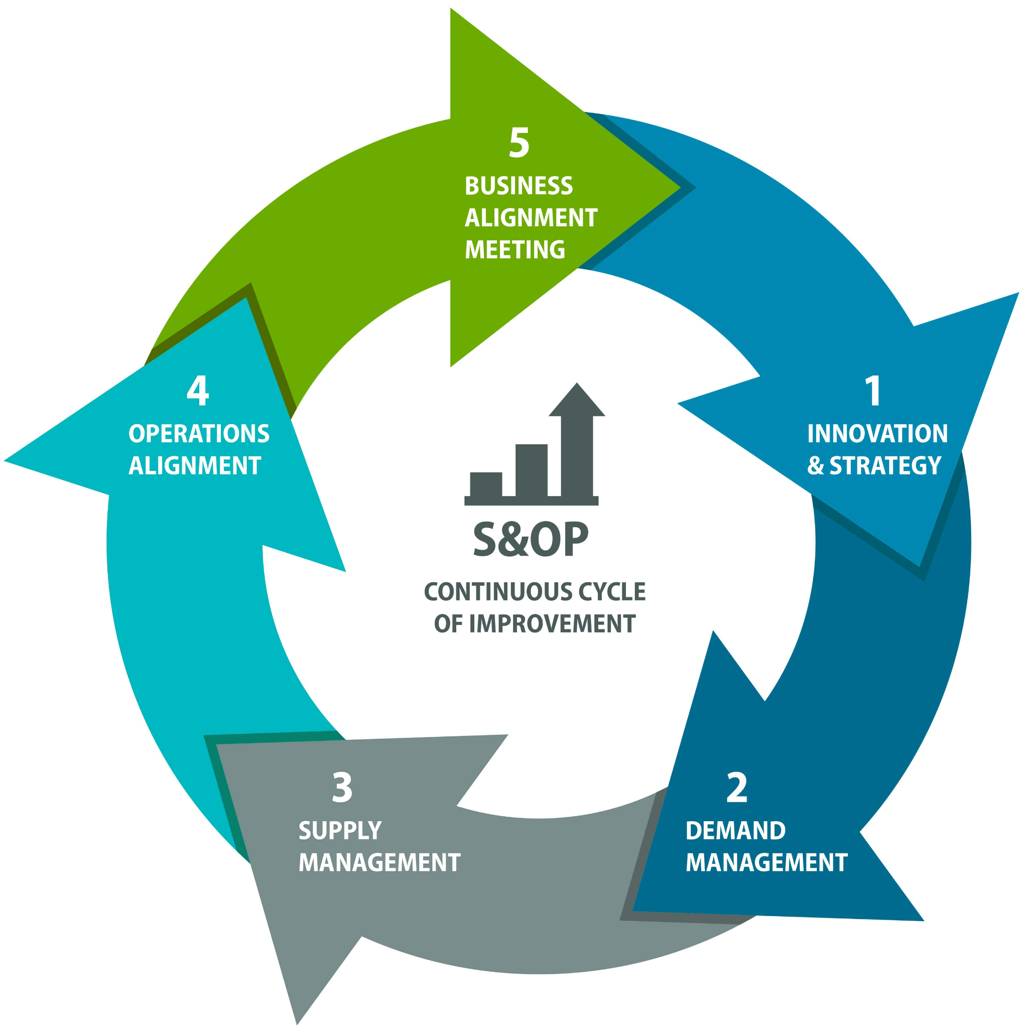
SALES & OPERATIONS PLANNING
SALES FORECAST
TARGET UNITS - 1000
TARGET MARKET
Primary - Utility Company
Secondary - Municipality
COMPETITOR ANALYSIS
Sensus
Aquasight
SALES CHANNELS
Direct Sales
Partnerships
FORECASTING OUTPUTS
Primary Market - 9000 target utilities & 10% adoption
Secondary Market - 1000 municipalities & 1% adoption
High Forecast —> + 5% & Low Forecast —> -1%
OPERATIONS
CAPACITY AND CAPABILITY PLANNING
3 - 5 additional software developers.
Upgrade server infrastructure.
Secure a partnership with a cloud service provider.
MASTER PRODUCTION SCHEDULE
Schedule sensor procurement based on confirmed customer orders. (2 month lead time)
DETAILED PLANNING AND EXECUTION
Develop detailed project plans for customer deployment, with a 4-week window from contract signing / installation / training.
Execute deployments according to the established plan, with a target 95% on-time completion rate.
Slide by Shruti

Slide 8

KEY INITIATIVES
MARKETING AND SALES
Develop case studies showcasing successful pilot deployments.
Train the sales team to highlight AquaChain's USP.
Identify and qualify 70 potential customers through events.
PILOT DEPLOYMENTS
Secure 5 pilot deployments with utility companies.
Collaborate with partners to implement AquaChain.
Gather feedback through user surveys with high satisfaction rate.
PRODUCT DEVELOPMENT AND IMPROVEMENT
Integrate a new feature - leak detection.
Develop a mobile app for real-time monitoring.
CUSTOMER ONBOARDING AND SUPPORT
Develop a streamlined onboarding process.
Establish a dedicated customer support team.
Conduct in-person training sessions for key customer personnel.
Slide by Shruti

Slide 9
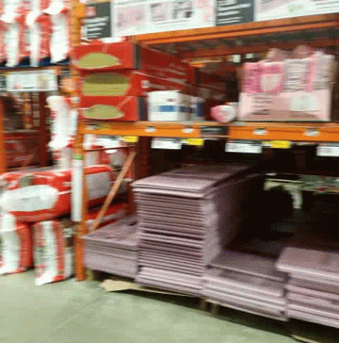
03
Material Requirement Planning
Slide by William

Slide 10
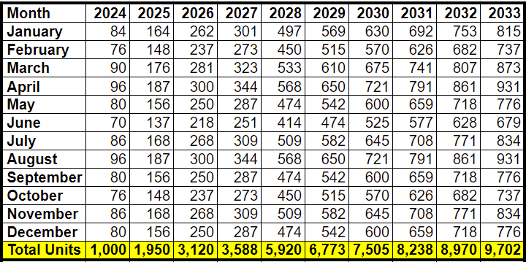

Master Production Schedule
In the case where our customers are not equipped with smart meters, the Master Schedule shown below will serve as our internal operating plan to fulfill customer demands.
Slide by William

Slide 11
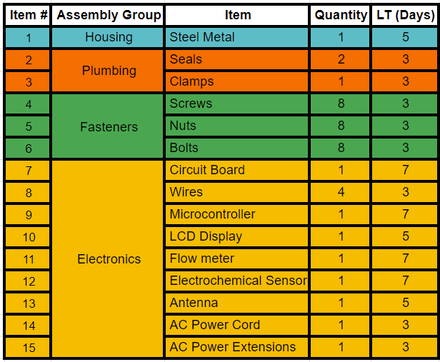
Bill of Materials
In the scenario where we need to act as the final integrator of subassemblies, the corresponding lead times for the items shown on the BOM will ensure OTD of materials. The inventory of these materials will be monitored by our MRP system to generate demand and subsequent POs.
Slide by William

Slide 12

04
Enterprise Resource Planning
Slide by Rachana

Slide 13
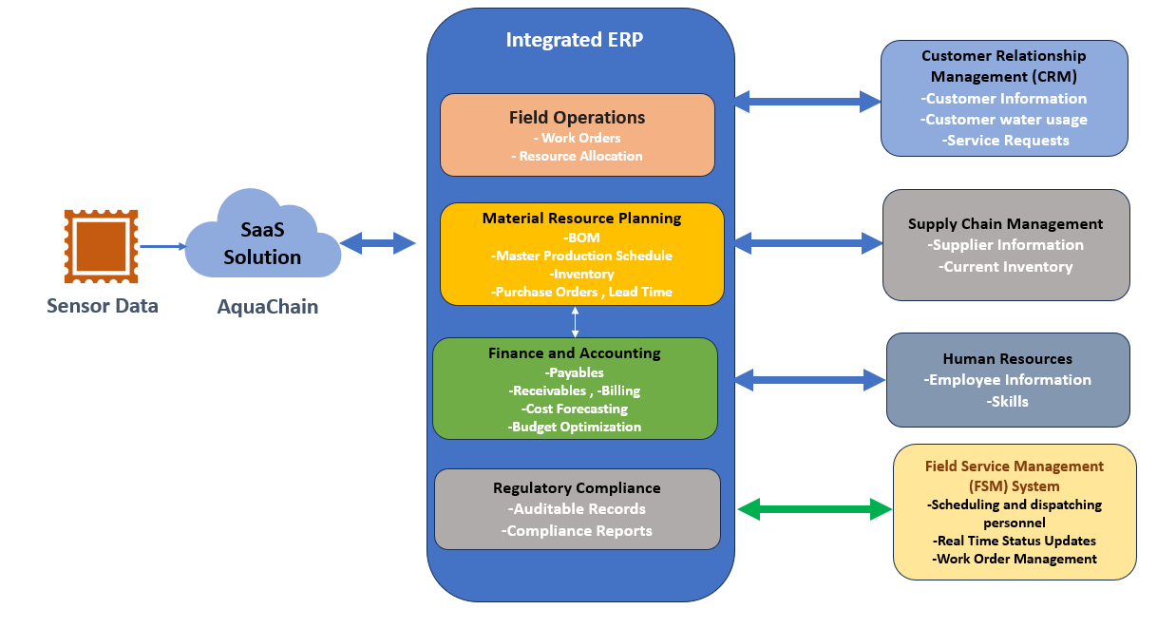
ERP MODEL
Slide by Rachana

Slide 14
ARCHITECTURE
AquaChain is a cloud-based platform that revolutionizes water management by collecting real-time water quality and usage data directly from deployed IoT sensors.
Integrated ERP
Connected Systems
Customer Relationship Management (CRM): Leverage water usage data for targeted water conservation campaigns and enhance customer service.
Supply Chain Management (SCM): Optimize procurement of water treatment chemicals and materials based on MRP triggers, ensuring efficient supply chains.
Field Service Management (FSM): Optimize scheduling and dispatch of field technicians based on real-time needs and skillsets, guaranteeing prompt and efficient field service.
Field Operations: Receive work orders based on sensor data, optimize resource allocation for, ensuring smooth and efficient operations.
Inventory Management: Track inventory levels in real-time, automate purchase orders based on projected usage, and guarantee sufficient stock for uninterrupted operations.
Material Requirements Planning (MRP): Analyze real-time data and lead times to precisely calculate material needs for water management ,streamlining procurement.
Finance & Accounting: Gain financial insights by analyzing water usage data to forecast water treatment costs and optimize budgets.
Regulatory Compliance: Maintain auditable records for water quality data, ensuring seamless compliance with regulations.
Slide by Rachana

Slide 15

05
Short Term Planning
Slide by Patrick

Slide 16
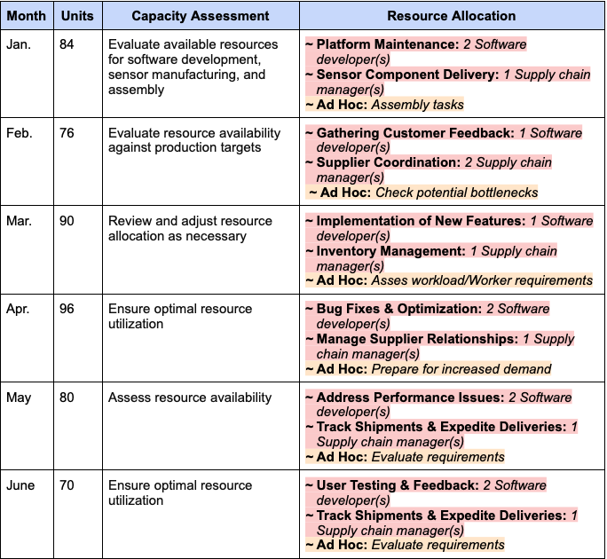
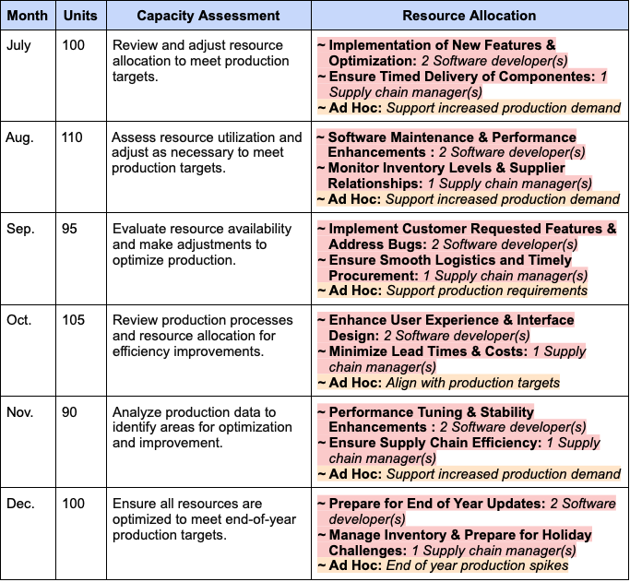
AquaChain’s Short Term Plan
*Tasks highlighted in red represent high priority actions and Ad Hoc’s highlighted in orange represent low-medium priority actions
Slide by Patrick

Slide 17
Thank You !
Any Questions?

